Slide 1
smart phone sales analysis

Slide 2
DATA COLLECTION the data was retrieved from the Flipkart website. Data was obtained on September 14, 2021; thus, it may differ somewhat from latest revisions. The information in the dataset is genuine.

Slide 3
EXPLORATORY DATA ANALYSIS : EDA is one of the most important phases in data science since it helps us to obtain critical insights and statistical metrics. In general, EDA can be categorised in two ways. The first distinction is that each method is either non-graphical or graphical. Second, each method is univariate or multivariate in nature (usually just bivariate). Non-graphical approaches typically include the computation of summary statistics, but graphical methods clearly summarize the data in a diagrammatic or pictorial manner. Let's look at each type individually.

Slide 4
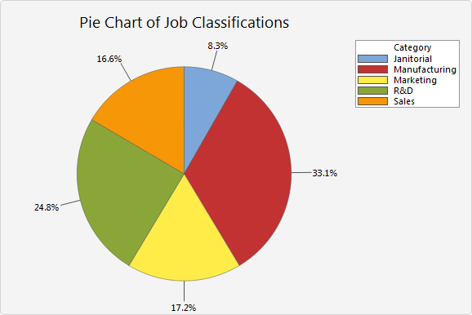
Pie Charts: Use pie charts to compare the sizes of categories to the entire dataset. To create a pie chart, you must have a categorical variable that divides your data into groups. These graphs consist of a circle (i.e., the pie) with slices representing subgroups. The size of each slice is proportional to the relative size of each category out of the whole.

Slide 5
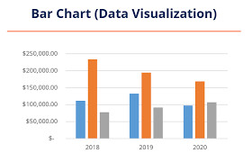
Bar Charts Bar charts, as a tool, can be used in two ways that are entirely different from each other. The first bar chart is used in data visualization that shows categorical data in the form of bars with varying heights or lengths based on the value it represents. Alternatively, bar charts can be used in the technical analysis of an asset or security over time. Bar charts used in technical analysis are very different compared to the regular bar charts used in data visualization.

Slide 6
INSTANCE OF THE DATASET

Slide 7
DESCRIPTIVE STATISTICS (NON-GRAPHICAL) In this section, we will look at the Measures of Central Tendency (Mean, Median, Mode) and Measures of Dispersion (Standard Deviation, Range and Quartiles).

Slide 8
Categorical Features

Slide 9
total no. of models by each companies
Row Labels | Count of model
Apple | 56
Poco | 56
Realme | 138
Samsung | 119
Xiaomi | 61
Grand Total | 430

Slide 10
total no. of sales
Apple | 1091.27
Poco | 2437.32
Realme | 4301.91
Samsung | 1261.9
Xiaomi | 3701.1
Grand Total | 12793.5

Slide 11
discounts by each company
Row Labels | Sum of discount_percent
Apple | 3.6
Poco | 9.08
Realme | 11.65
Samsung | 15.91
Xiaomi | 6.2
Grand Total | 46.44

Slide 12
ratings of brands
Row Labels | Sum of ratings
Apple | 255.5
Poco | 242.2
Realme | 599.4
Samsung | 504.8
Xiaomi | 264
Grand Total | 1865.9

Slide 13
battery capacity
Row Labels | Average of battery_capacity
Apple | 2765.196429
Poco | 5247.321429
Realme | 4797.318841
Samsung | 4846.218487
Xiaomi | 4265.737705
Grand Total | 4529.397674

Slide 14
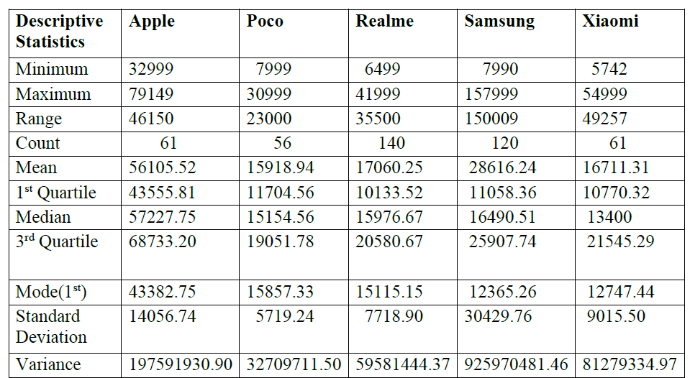
DESCRIPTIVE STATISTICS FOR SALES PRICE FOR DIFFERENT BRANDS

